Slide 1
Cell Division
Chapter 8

Slide 2
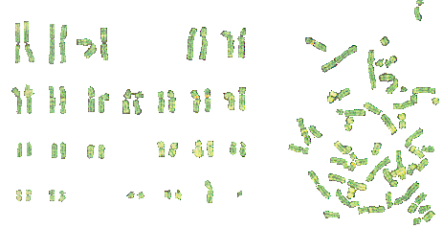
Chromosomes
DNA is tightly packed (coiled) in the nucleus
Only visible during cell division

Slide 3
Chromosome Types (animals)
Sex Chromosomes
  Determine the sex of an organism
  XX = Female
  XY = Male
Autosome
  Any chromosome that is NOT a sex chromosome
  2 Copies of each autosome
  Humans: 23 Autosomes x 2 copies = 46 Chromosomes! (Adder’s tongue fern has 1,262!!)

Slide 4
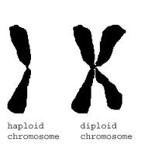
Haploid vs. Diploid Cells
Haploid
  Only ONE set of chromosomes
  Egg and Sperm (reproductive cells)
Diploid
  Cells that have 2 sets of chromosomes
  All normal (non-reproductive) human cells are diploid

Slide 5
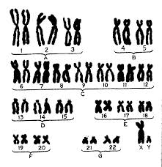
Karyotype
A picture of a person’s chromosomes
Can be used to determine genetic abnormalities

Slide 6
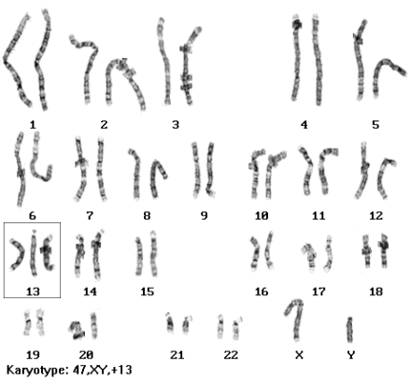
Patau Syndrome
Abnormal number of chromosomes
Trisomy-13
Have 47 chromosomes instead of 46
Serious eye, brain, circulatory defects

Slide 7
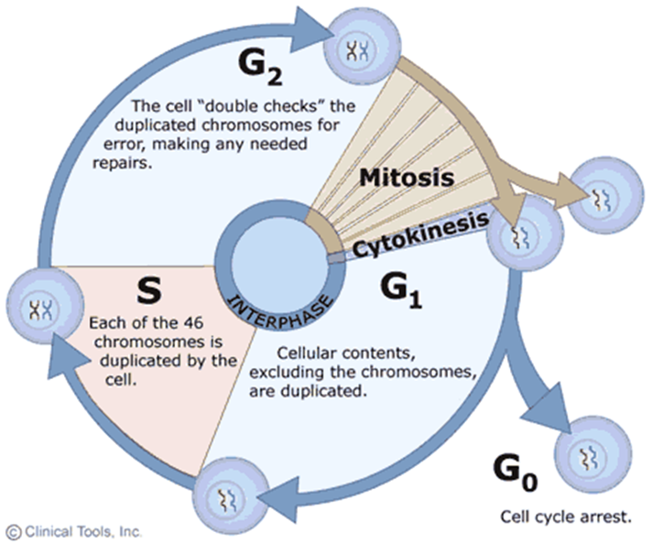
Cell Cycle

Slide 8
Mitosis
Biology

Slide 9
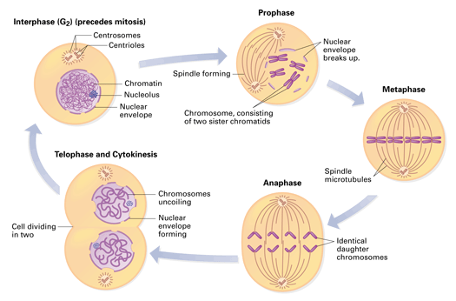

Slide 10
Cell division Includes
Interphase and Mitotic phases
Interphase:
Cell is experiencing growth and metabolism. It looks “normal”
G-1-Growth
S-phase-DNA, while still in the form of chromatin replicates
G-2-More growth and metabolism; organelles replicate and cell increases volume

Slide 11
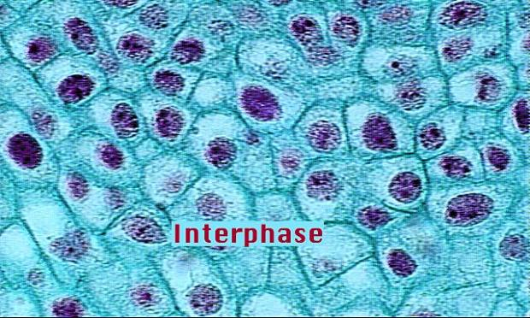
Interphase
copyright cmassengale
Notes:
11

Slide 12
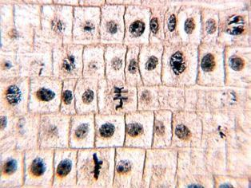
Cells Undergoing Mitosis
copyright cmassengale
Notes:
12

Slide 13
Mitotic phases
Prophase:
Chromatin starts to compact into chromosomes.
The nuclear envelope breaks down.
Centrioles (in animal cells) replicate & move to the poles.
Spindle fibers start to form.
The nucleolus breaks down.

Slide 14
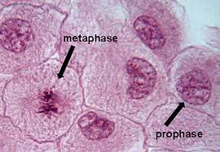
Prophase

Slide 15
Metaphase
The spindle apparatus is fully formed.
Chromosomes attach to the spindle fibers by kinetochores and are lined up in the middle, along what is called the equatorial plane (or metaphase plate).
Late in this phase, the centromeres of the chromosomes split.

Slide 16
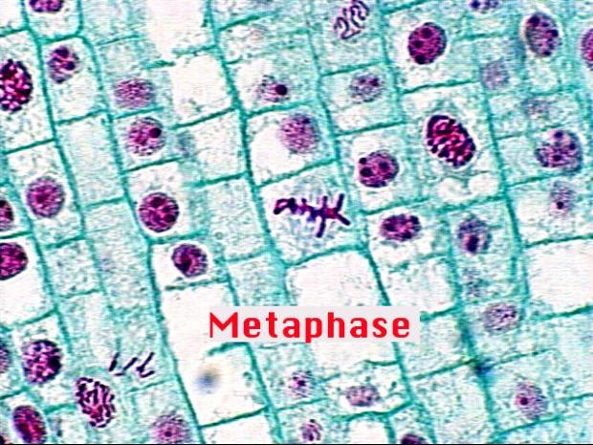
Metaphase
copyright cmassengale
Notes:
16

Slide 17
Anaphase
Spindle fibers contract and pull the separated chromatids to opposite poles of the cell.

Slide 18
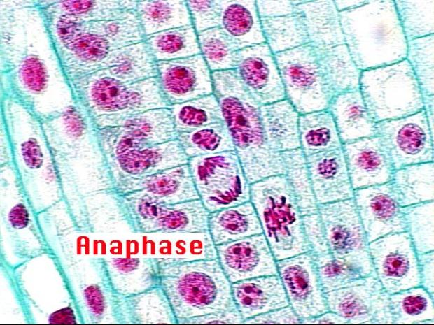
Anaphase
copyright cmassengale
Notes:
18

Slide 19
Telophase
The nuclear membrane reassembles.
The nucleolus reappears.
The chromosomes begin to relax back into chromatin.
Spindle fibers break down.
The pairs of centrioles remain at opposite poles that each new cell has one pair.

Slide 20
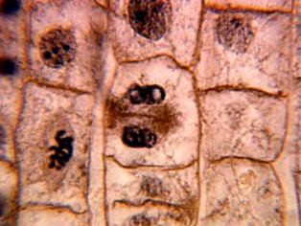
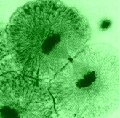
Telophase
Plant
Animal
copyright cmassengale
Notes:
20

Slide 21
Cytokinesis
This is where the cytoplasm and its contents are divided.
This overlaps with Telophase
The constriction that appears in animal cells is called the cleavage furrow.
In plant cells, a new cell wall is built across the middle.

Slide 22
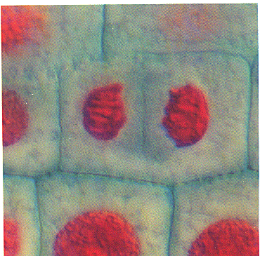
Cytokinesis
Cell Plate Forming in Plant Cells
copyright cmassengale
Notes:
22

Slide 23
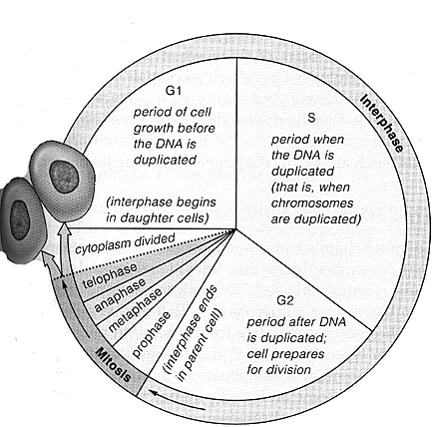
Mitosis cell cycle

Slide 24
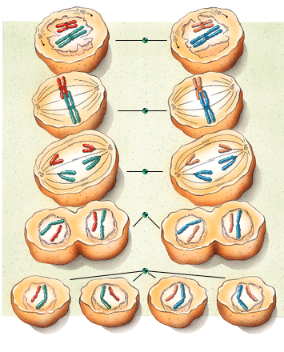
Meiosis
Gamete Production

Slide 25
Meiosis
Similar in many ways to mitosis
Several differences however
  Involves 2 cell divisions
  Results in 4 cells with 1/2 the normal genetic information.
Vocabulary:
  Diploid (2N) - Normal amount of genetic material
  Haploid (N) - 1/2 the genetic material.

Slide 26
Meiosis
Meiosis results in the formation of haploid cells.
In Humans, these are the Ova (egg) and sperm.
Ova are produced in the ovaries in females
    Process is called oogenesis
Sperm are produced in the testes of males.
    Process is called spermatogenesis
Meiosis occurs in 2 phases: Meiosis I & Meiosis II

Slide 27
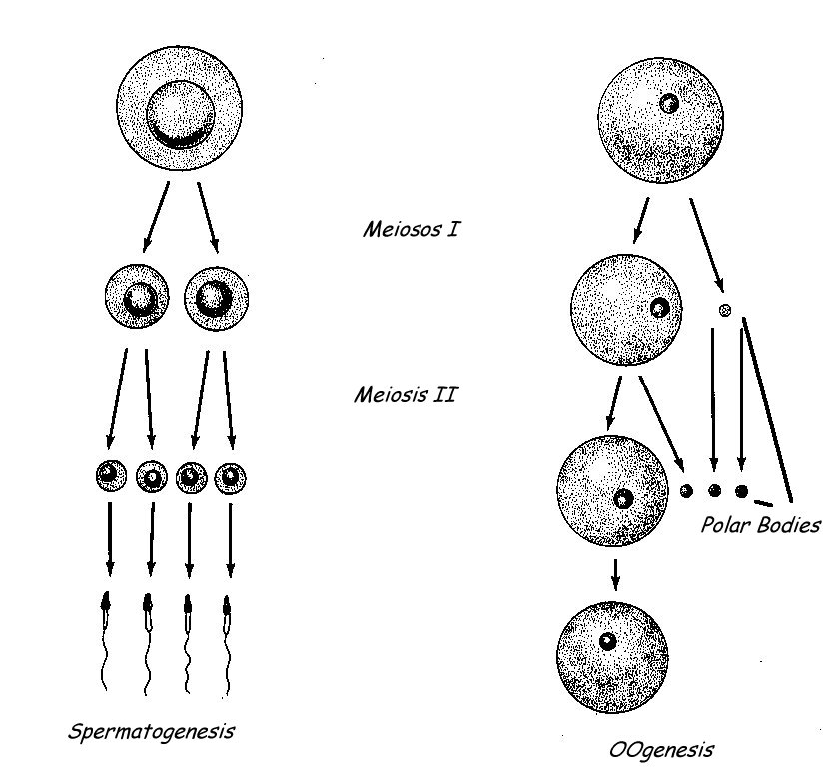
Spermatogenesis & Oogenesis
Sperm formation
Egg formation

Slide 28
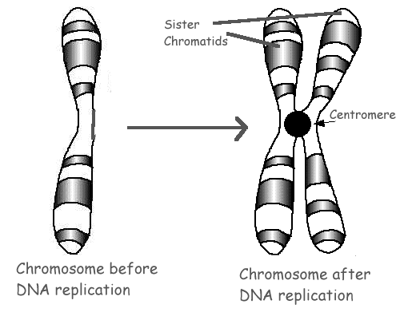
Meiosis I
Prior to division (S phase), amount of DNA doubles

Slide 29
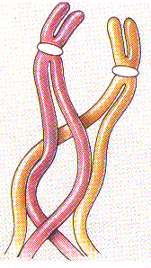
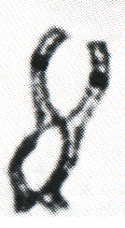
Metaphase I
During Metaphase I homologous chromosomes line-up along the metaphase plate or EQUATOR
Areas of homologous chromosomes connect at areas called CHIASMATA
Genes are exchanged at these connections

Slide 30
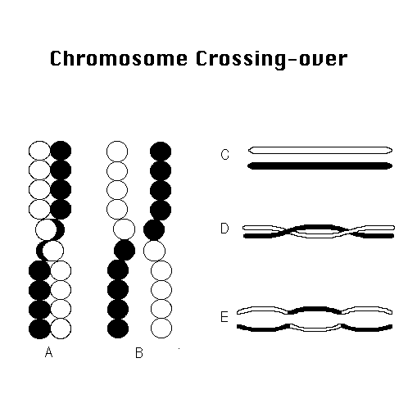
Crossing Over
Segments of homologous chromosomes break and reattach at similar locations.
Results in new genetic combinations of offspring.
This is the main advantage of sexual reproduction

Slide 31
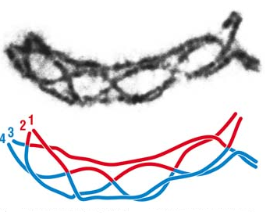
Chiasmata

Slide 32
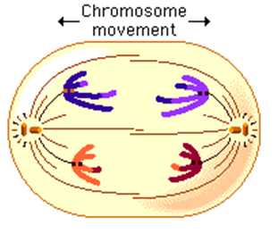
Anaphase I
During Anaphase I, each HOMOLOGOUS CHROMOSOME is pulled to opposite sides of the cell.
Unlike mitosis, the CENTROMERES DO NOT BREAK.
Nuclei MAY OR MAY NOT reform following division.
CYTOKENESIS may or may not occur.

Slide 33
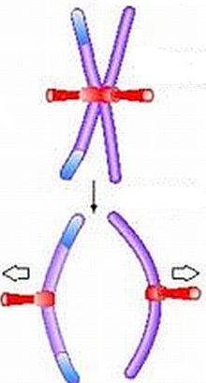
Meiosis II
DNA DOES NOT double
Chromosomes randomly line-up along metaphase plate like regular mitosis.
During Anaphase II, CENTROMERES BREAK and each SISTER CHROMATID is pulled to opposite sides of the cell.
Nuclei reform and cytokinesis usually occurs (although it is often unequal).
Sister chromatids

Slide 34
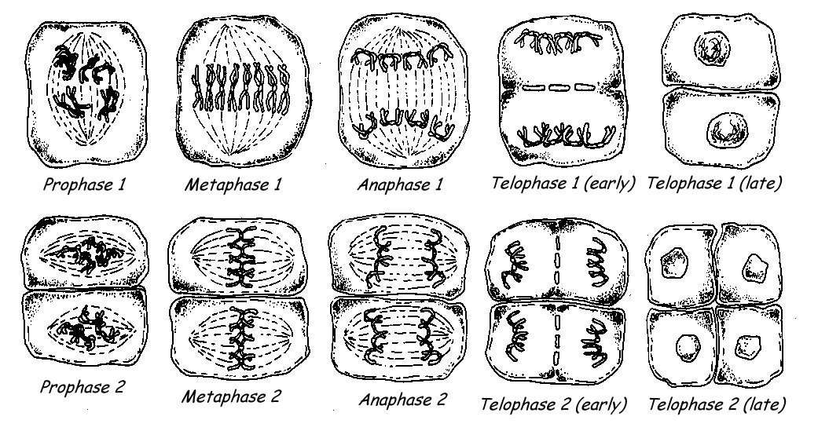
Overview of Meiosis

