Slide 1
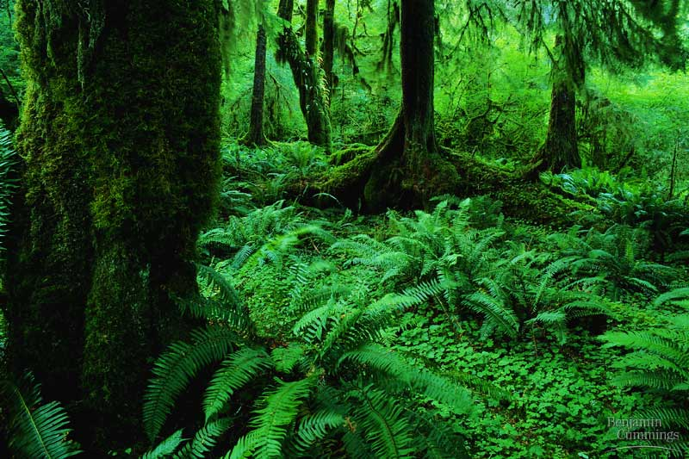

Slide 2
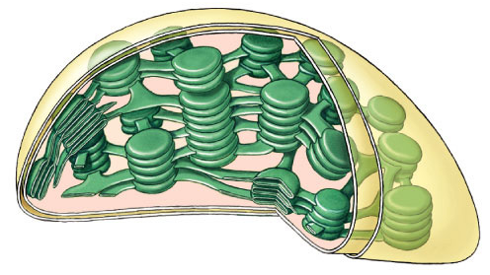
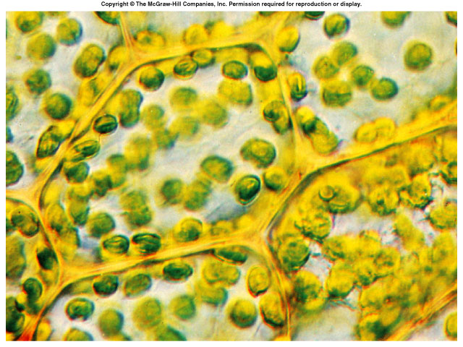
Photosynthesis:
Life from Light and Air

Slide 3
Energy needs of life
All life needs a constant input of energy
  Heterotrophs (Animals)
    get their energy from “eating others”
      eat food = other organisms = organic molecules
    make energy through respiration
  Autotrophs (Plants)
    produce their own energy (from “self”)
    convert energy of sunlight
    build organic molecules (CHO) from CO₂
    make energy & synthesize sugars through photosynthesis
consumers
producers

Slide 4
How are they connected?
Heterotrophs
making energy & organic molecules from ingesting organic molecules
glucose + oxygen → carbon + water + energy
dioxide
C₆H₁₂O₆
+
6O₂
→
6CO₂
+
6H₂O
+
ATP
oxidation = exergonic
Autotrophs
Where’s
the ATP?
making energy & organic molecules from light energy
carbon
dioxide
+ water + energy → glucose + oxygen
6CO₂
+
6H₂O
+
light
energy
→
C₆H₁₂O₆
+
6O₂
reduction = endergonic
Notes:
So, in effect, photosynthesis is respiration run backwards powered by light.
Cellular Respiration
oxidize C₆H₁₂O₆ → CO₂ & produce H₂O
fall of electrons downhill to O₂
exergonic
Photosynthesis
reduce CO₂ → C₆H₁₂O₆ & produce O₂
boost electrons uphill by splitting H₂O
endergonic

Slide 5
What does it mean to be a plant
Need to…
  collect light energy
    transform it into chemical energy
  store light energy
    in a stable form to be moved around
    the plant or stored
  need to get building block atoms
  from the environment
    C,H,O,N,P,K,S,Mg
  produce all organic molecules
  needed for growth
    carbohydrates, proteins, lipids, nucleic acids
ATP
glucose
CO₂
H₂O
N
K
P
…

Slide 6
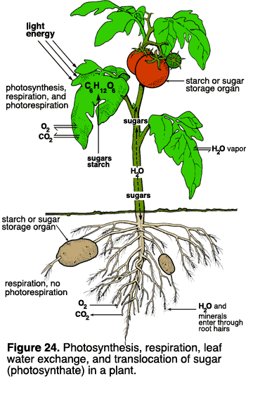
Plant structure
Obtaining raw materials
  sunlight
    leaves = solar collectors
  CO₂
    stomates = gas exchange
  H₂O
    uptake from roots
  nutrients
    N, P, K, S, Mg, Fe…
    uptake from roots

Slide 7
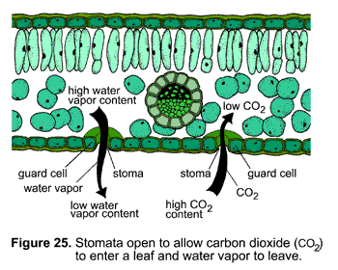
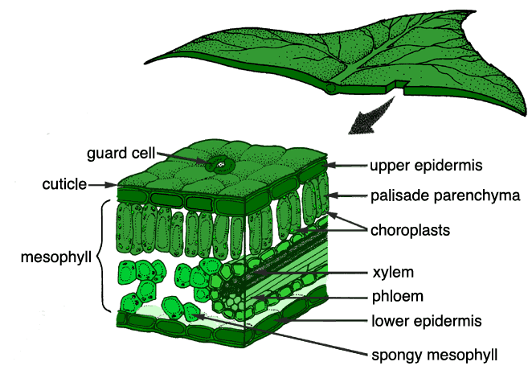
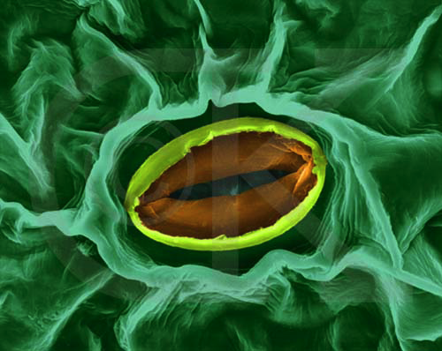
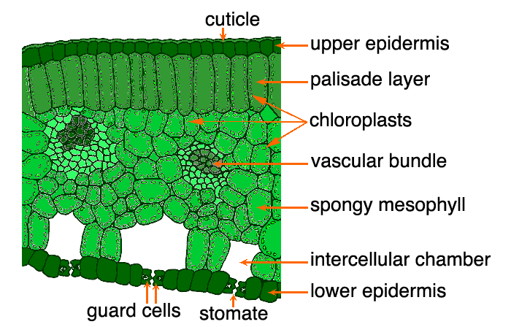
stomate
transpiration
gas exchange

Slide 8
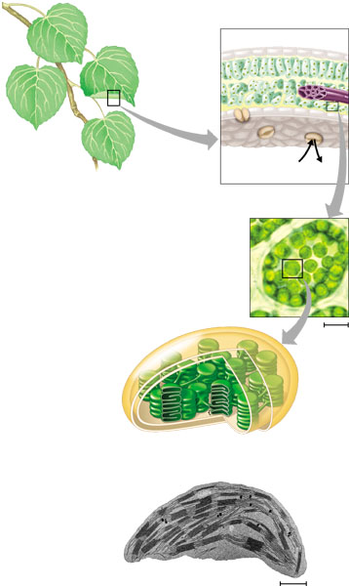
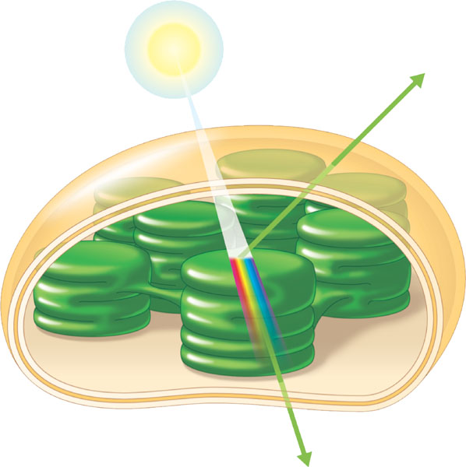
Chloroplasts
cross section
of leaf
absorb
sunlight & CO₂
leaves
CO₂
chloroplasts
in plant cell
chloroplasts
contain
chlorophyll
chloroplast
make
energy & sugar

Slide 9
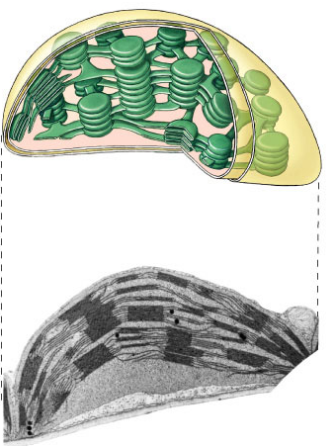
Plant structure
chloroplast
H⁺
H⁺
H⁺
H⁺
H⁺
H⁺
H⁺
H⁺
H⁺
ATP
H⁺
H⁺
thylakoid
Chloroplasts
  double membrane
  stroma
    fluid-filled interior
  thylakoid sacs
  grana stacks
Thylakoid membrane contains
  chlorophyll molecules
  electron transport chain
  ATP synthase
    H⁺ gradient built up within thylakoid sac
outer membrane
inner membrane
stroma
thylakoid
granum
Notes:
A typical mesophyll cell has 30-40 chloroplasts, each about 2-4 microns by 4-7 microns long.
Each chloroplast has two membranes around a central aqueous space, the stroma.
In the stroma are membranous sacs, the thylakoids.
These have an internal aqueous space, the thylakoid lumen or thylakoid space.
Thylakoids may be stacked into columns called grana.

Slide 10
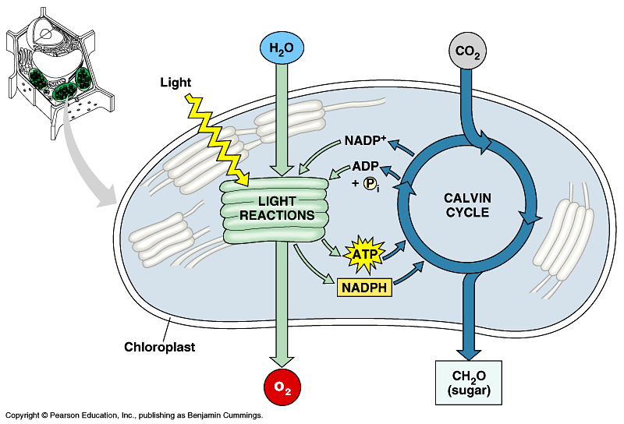

Photosynthesis
Light reactions
  light-dependent reactions
  energy conversion reactions
    convert solar energy to chemical energy
    ATP & NADPH
Calvin cycle
  light-independent reactions
  sugar building reactions
    uses chemical energy (ATP & NADPH) to reduce CO₂ & synthesize C₆H₁₂O₆
It’s not the
Dark Reactions!

Slide 11
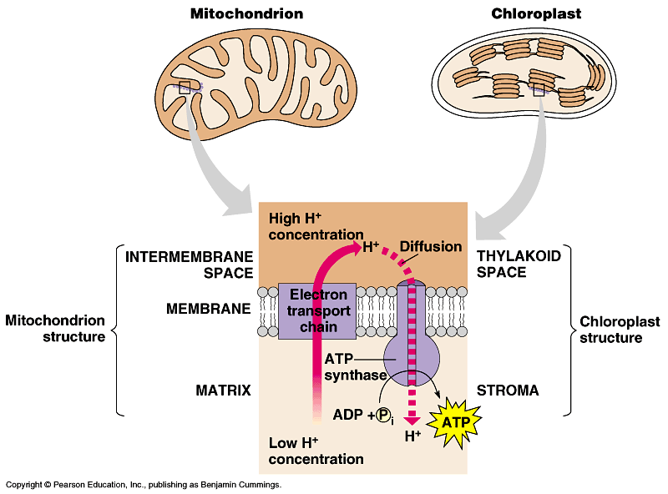
Light reactions
chloroplast
thylakoid
H⁺
H⁺
H⁺
H⁺
H⁺
H⁺
H⁺
H⁺
H⁺
H⁺
H⁺
H⁺
H⁺
H⁺
H⁺
H⁺
ATP
H⁺
H⁺
H⁺
H⁺
H⁺
H⁺
Electron Transport Chain
    like in cellular respiration
  proteins in organelle membrane
  electron acceptors
    NADPH
  proton (H⁺)
  gradient across
  inner membrane
    find the double membrane!
  ATP synthase
  enzyme
Notes:
Not accidental that these 2 systems are similar, because both derived from the same primitive ancestor.

Slide 12
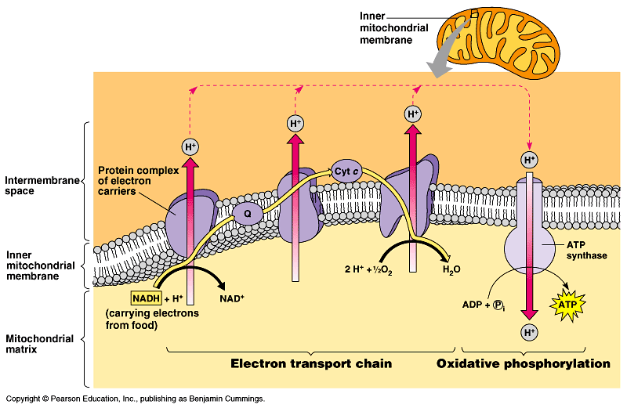
ETC of Respiration
Mitochondria transfer chemical energy from food molecules into chemical energy of ATP
  use electron carrier NADH
generates H₂O
Notes:
NADH is an input
ATP is an output
O₂ combines with H⁺’s to form water
Electron is being handed off from one electron carrier to another -- proteins, cytochrome proteins & quinone lipids
So what if it runs in reverse??

Slide 13
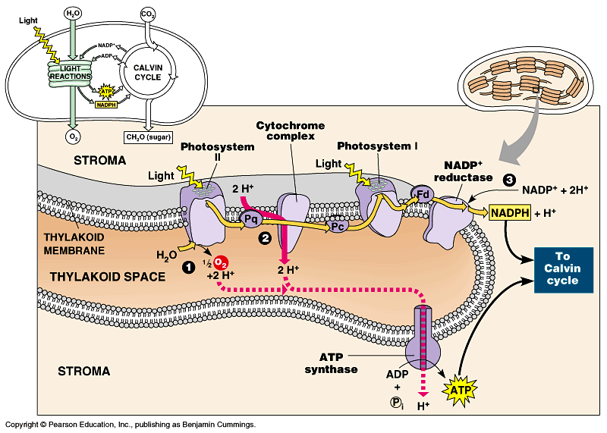
ETC of Photosynthesis
Chloroplasts transform light energy into chemical energy of ATP
  use electron carrier NADPH
generates O₂
Notes:
Two places where light comes in.
Remember photosynthesis is endergonic -- the electron transport chain is driven by light energy.
Need to look at that in more detail on next slide

Slide 14
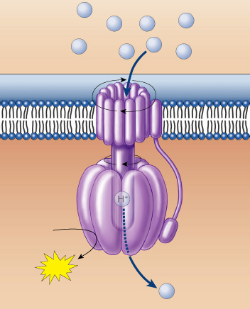
The ATP that “Jack” built
photosynthesis
respiration
sunlight
breakdown of C₆H₁₂O₆
H⁺
H⁺
H⁺
H⁺
H⁺
H⁺
H⁺
H⁺
    moves the electrons
    runs the pump
    pumps the protons
    builds the gradient
    drives the flow of protons
    through ATP synthase
    bonds P_{i} to ADP
    generates the ATP
    … that evolution built
ADP + P_{i}
ATP
H⁺

Slide 15
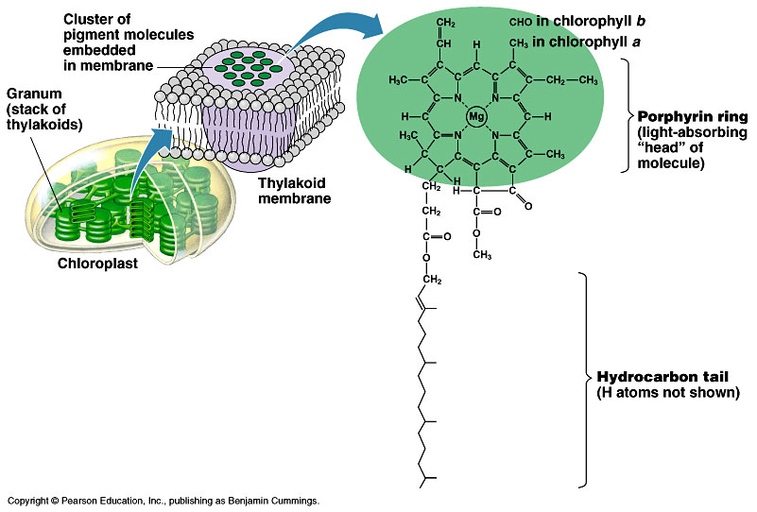
Pigments of photosynthesis
How does this
molecular structure
fit its function?
Chlorophylls & other pigments
  embedded in thylakoid membrane
  arranged in a “photosystem”
    collection of molecules
  structure-function relationship

Slide 16
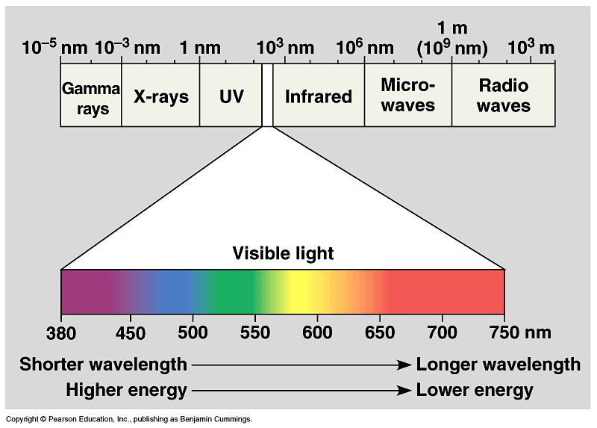
A Look at Light
The spectrum of color
V
I
B
G
Y
O
R

Slide 17
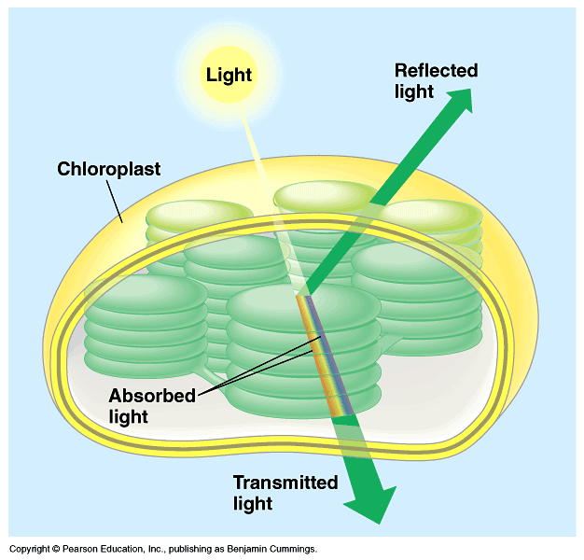
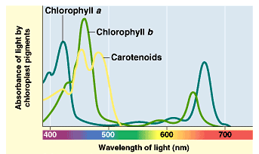
Light: absorption spectra
Photosynthesis gets energy by absorbing wavelengths of light
  chlorophyll a
    absorbs best in red & blue wavelengths & least in green
  accessory pigments with different structures absorb light of different wavelengths
    chlorophyll b, carotenoids, xanthophylls
Why are
plants green?

Slide 18
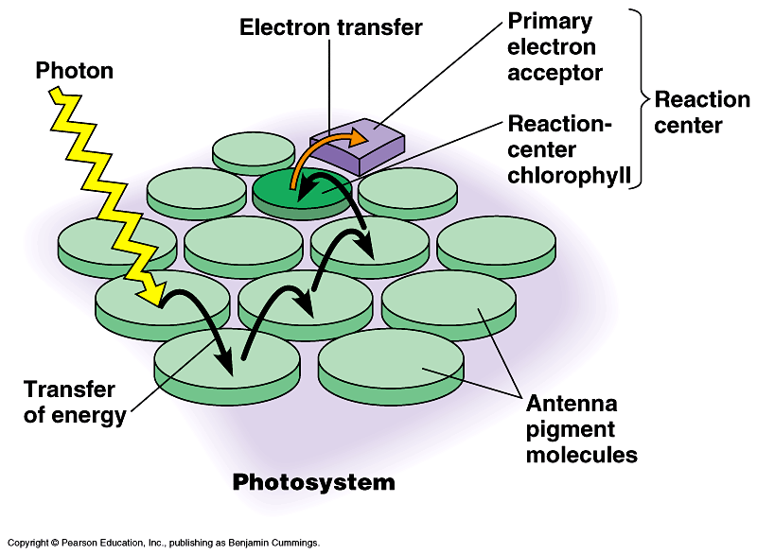
Photosystems of photosynthesis
2 photosystems in thylakoid membrane
  collections of chlorophyll molecules
  act as light-gathering molecules
  Photosystem II
    chlorophyll a
    P₆₈₀ = absorbs 680nm
    wavelength red light
  Photosystem I
    chlorophyll b
    P₇₀₀ = absorbs 700nm
    wavelength red light
reaction
center
antenna
pigments
Notes:
Photons are absorbed by clusters of pigment molecules (antenna molecules) in the thylakoid membrane.
When any antenna molecule absorbs a photon, it is transmitted from molecule to molecule until it reaches a particular chlorophyll a molecule = the reaction center.
At the reaction center is a primary electron acceptor which removes an excited electron from the reaction center chlorophyll a.
This starts the light reactions.
Don’t compete with each other, work synergistically using different wavelengths.

Slide 19
ETC of Photosynthesis
chlorophyll a
Photosystem II
chlorophyll b
Photosystem I
Notes:
Two places where light comes in.
Remember photosynthesis is endergonic -- the electron transport chain is driven by light energy.
Need to look at that in more detail on next slide

Slide 20
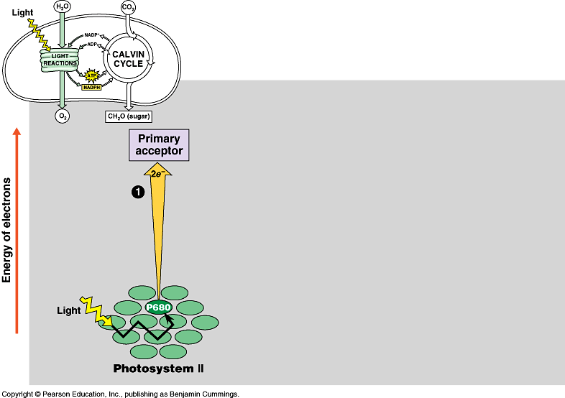
ETC of Photosynthesis
sun
1
e
e
Photosystem II
P680
chlorophyll a
Notes:
PS II absorbs light
Excited electron passes from chlorophyll to the primary electron acceptor
Need to replace electron in chlorophyll
An enzyme extracts electrons from H₂O & supplies them to the chlorophyll
This reaction splits H₂O into 2 H⁺ & O⁻ which combines with another O⁻ to form O₂
O₂ released to atmosphere
Chlorophyll absorbs light energy (photon) and this moves an electron to a higher energy state
Electron is handed off down chain from electron acceptor to electron acceptor
In process has collected H⁺ ions from H₂O & also pumped by Plastoquinone within thylakoid sac.
Flow back through ATP synthase to generate ATP.

Slide 21
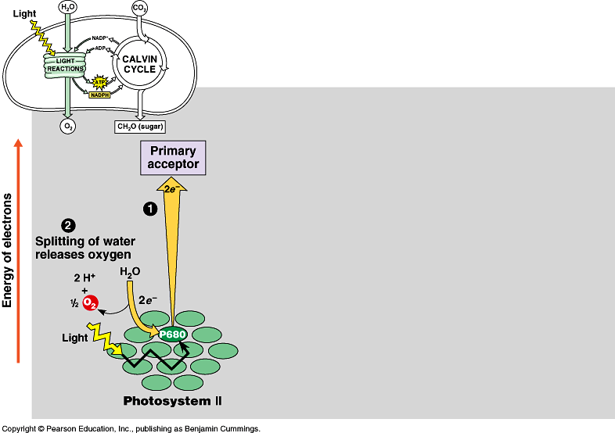
Inhale, baby!
ETC of Photosynthesis
chloroplast
thylakoid
H⁺
H⁺
H⁺
H⁺
H⁺
H⁺
H⁺
H⁺
H⁺
H⁺
H⁺
H⁺
H⁺
H⁺
H⁺
H⁺
ATP
H⁺
H⁺
H⁺
H⁺
H⁺
H⁺
Plants SPLIT water!
1
H
H
2
O
e
e
O
H
H
O
e⁻
H⁺
+H
e⁻
e
e
fill the e– vacancy
Photosystem II
P680
chlorophyll a

Slide 22
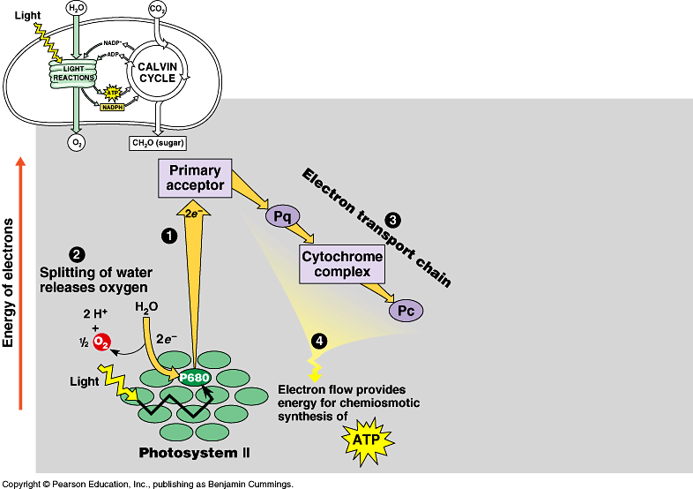
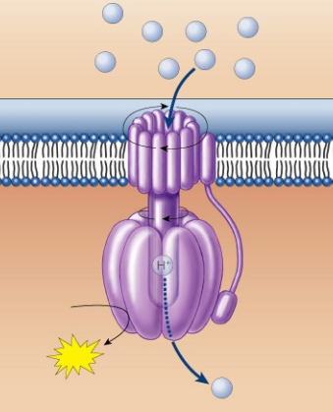
ETC of Photosynthesis
chloroplast
thylakoid
H⁺
H⁺
H⁺
H⁺
H⁺
H⁺
H⁺
H⁺
H⁺
H⁺
H⁺
H⁺
H⁺
H⁺
H⁺
H⁺
ATP
H⁺
H⁺
H⁺
H⁺
H⁺
H⁺
e
e
3
1
2
H⁺
e
e
ATP
4
H⁺
to Calvin Cycle
H⁺
H⁺
H⁺
H⁺
H⁺
H⁺
H⁺
H⁺
energy to build
carbohydrates
Photosystem II
P680
chlorophyll a
ATP
ADP + P_{i}
H⁺

Slide 23
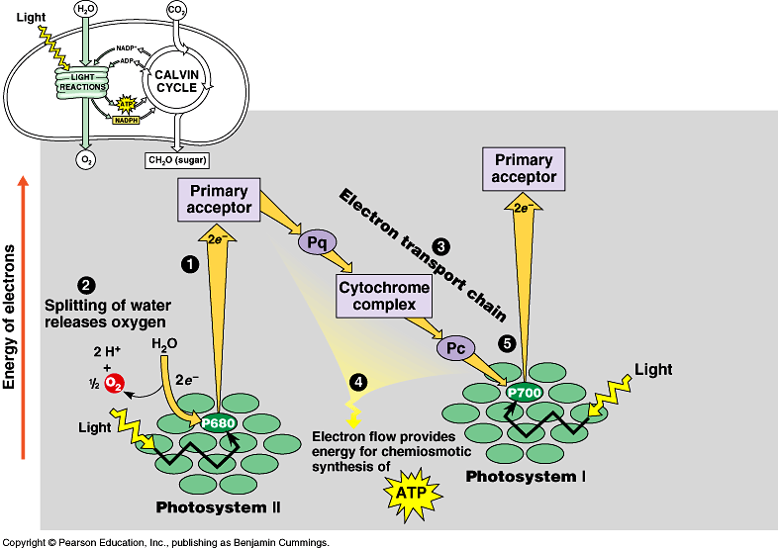
ETC of Photosynthesis
e
e
e
sun
e
fill the e– vacancy
e
5
e
e
e
Photosystem I
P700
chlorophyll b
Photosystem II
P680
chlorophyll a
Notes:
Need a 2nd photon -- shot of light energy to excite electron back up to high energy state.
2nd ETC drives reduction of NADP to NADPH.
Light comes in at 2 points.
Produce ATP & NADPH

Slide 24
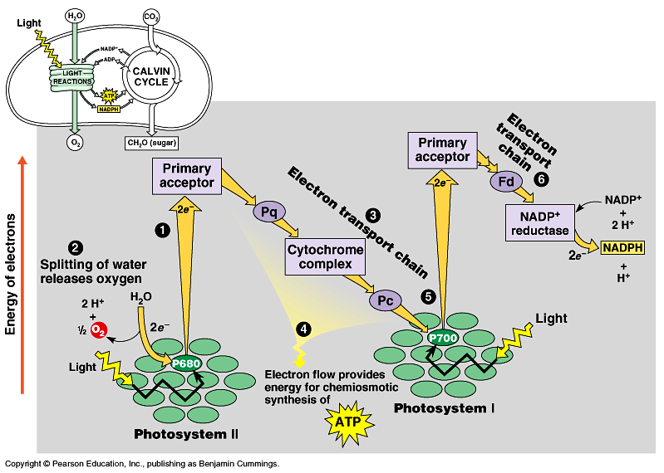

ETC of Photosynthesis
electron carrier
e
e
6
e
e
5
sun
NADPH to
Calvin Cycle
Photosystem I
P700
chlorophyll b
Photosystem II
P680
chlorophyll a
$$ in the bank…
reducing power!
Notes:
Need a 2nd photon -- shot of light energy to excite electron back up to high energy state.
2nd ETC drives reduction of NADP to NADPH.
Light comes in at 2 points.
Produce ATP & NADPH

Slide 25

ETC of Photosynthesis
sun
sun
e
e
e
e
H⁺
H⁺
H⁺
O
H⁺
H⁺
H⁺
H⁺
H⁺
to Calvin Cycle
H⁺
H⁺
H⁺
split H₂O
ATP
Notes:
Two places where light comes in.
Remember photosynthesis is endergonic -- the electron transport chain is driven by light energy.
Need to look at that in more detail on next slide

Slide 26
ETC of Photosynthesis
ETC uses light energy to produce
  ATP & NADPH
    go to Calvin cycle
PS II absorbs light
  excited electron passes from chlorophyll to “primary electron acceptor”
  need to replace electron in chlorophyll
  enzyme extracts electrons from H₂O & supplies them to chlorophyll
    splits H₂O
    O combines with another O to form O₂
    O₂ released to atmosphere
    and we breathe easier!

Slide 27
Experimental evidence
Where did the O₂ come from?
  radioactive tracer = O₁₈
Experiment 1
light
energy
→
6CO₂
+
6H₂O
+
light
energy
→
+
6O₂
6CO₂
+
6H₂O
+
C₆H₁₂O₆
+
6O₂
C₆H₁₂O₆
Experiment 2
6CO₂
+
6H₂O
+
light
energy
→
C₆H₁₂O₆
+
6O₂
Proved O₂ came from H₂O not CO₂ = plants split H₂O!

Slide 28
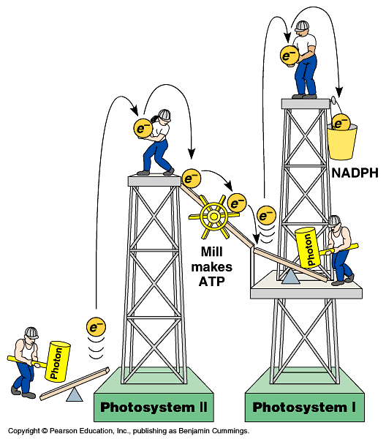

Noncyclic Photophosphorylation
Light reactions elevate electrons in
2 steps (PS II & PS I)
  PS II generates
  energy as ATP
  PS I generates
  reducing power as NADPH
ATP
Notes:
1 photosystem is not enough.
Have to lift electron in 2 stages to a higher energy level. Does work as it falls.
First, produce ATP -- but producing ATP is not enough.
Second, need to produce organic molecules for other uses & also need to produce a stable storage molecule for a rainy day (sugars). This is done in Calvin Cycle!

Slide 29
Cyclic photophosphorylation
If PS I can’t pass electron to NADP…it cycles back to PS II & makes more ATP, but no NADPH
  coordinates light reactions to Calvin cycle
  Calvin cycle uses more ATP than NADPH

ATP
18 ATP +
12 NADPH
→
1 C₆H₁₂O₆

Slide 30
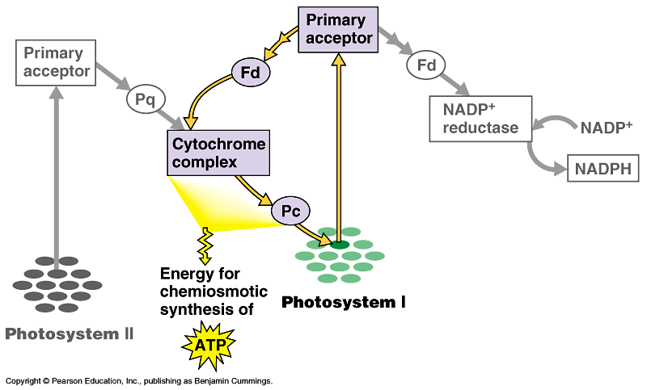
Photophosphorylation
cyclic
photophosphorylation
NADP
NONcyclic
photophosphorylation
ATP

Slide 31
Photosynthesis summary
Where did the energy come from?
Where did the electrons come from?
Where did the H₂O come from?
Where did the O₂ come from?
Where did the O₂ go?
Where did the H⁺ come from?
Where did the ATP come from?
What will the ATP be used for?
Where did the NADPH come from?
What will the NADPH be used for?
…stay tuned for the Calvin cycle
Notes:
Where did the energy come from? The Sun
Where did the electrons come from? Chlorophyll
Where did the H₂O come from?
The ground through the roots/xylem
Where did the O₂ come from? The splitting of water
Where did the O₂ go? Out stomates to air
Where did the H⁺ come from? The slitting of water
Where did the ATP come from?
Photosystem 2: Chemiosmosis (H+ gradient)
What will the ATP be used for?
The work of plant life! Building sugars
Where did the NADPH come from?
Reduction of NADP (Photosystem 1)
What will the NADPH be used for? Calvin cycle / Carbon fixation

Slide 32
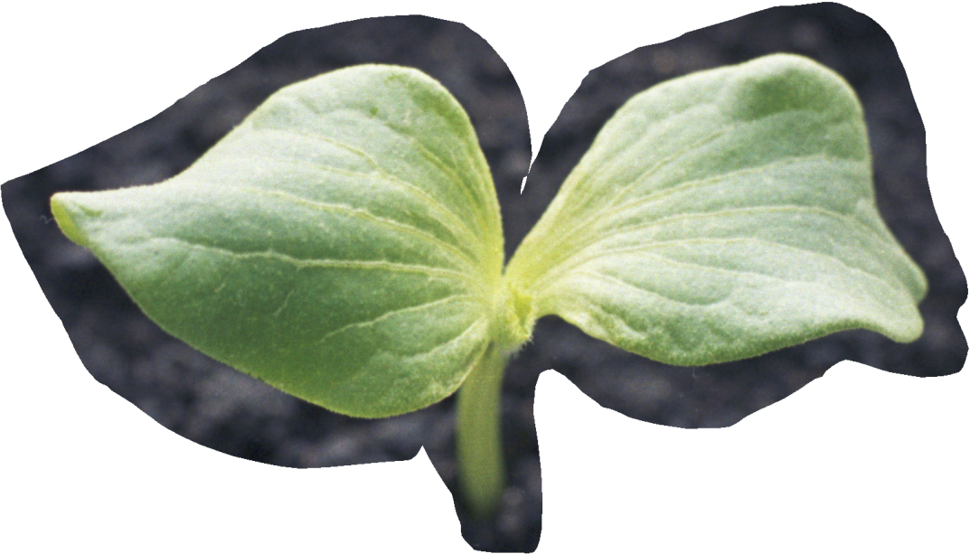
You can grow if you
Ask Questions!

Slide 33
Ghosts of Lectures Past
(storage)

Slide 34
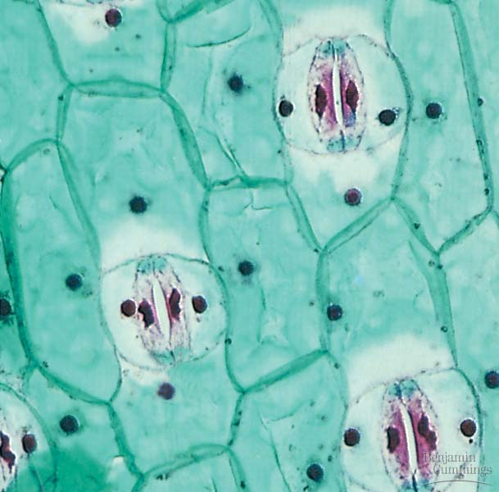
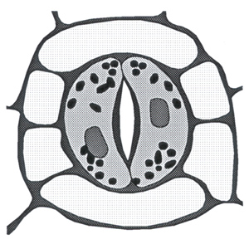
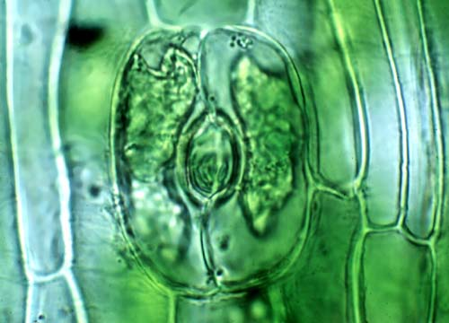
Stomates

